Slide 1
CSS-Bootstrap
Static Restaurant(2)

Slide 2
Webpage's Component
index.html: main html file
style.css: css file
bootstrap

Slide 3
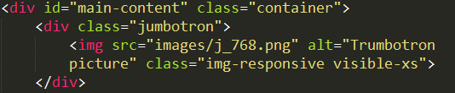





Main content - jumbotron
jumbotron for extrasmall devices
jumbotron attributes that shares with all screensize
Media queries for large devices
Media queries for large devices
Media queries for small devices

Slide 4
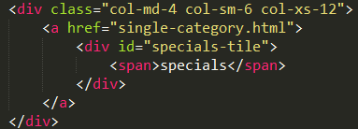
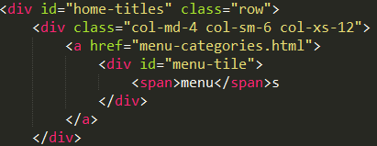
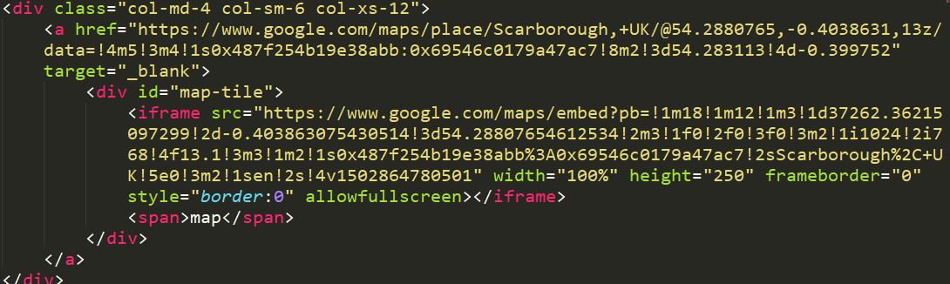
Main content - tiles
Menu-tile
specials-tile
took 4/12 of large, medium screen,6/12 of small screen and 12/12 of extra small screen.
map-tile

Slide 5
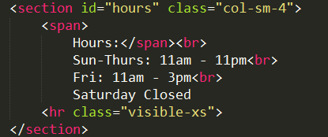
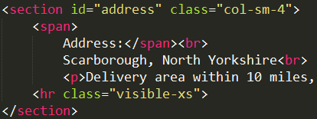

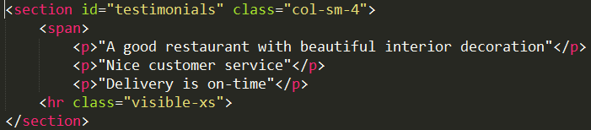
Footer
Footer and container
2nd footer column, 4/12 of the width
1st footer column, 4/12 of the width
The copyright logo
3rd footer column, 4/12 of the width

